Slide 1
Intern Project Report Prepared by: Hairu Wen Date: Sep 30, 2024

Slide 2
Use Case and Problem Statement
What problems should this project solve for the clients?
Problem Statement
Insurance brokers and insurance companies face numerous operational challenges due to the complexity and volume of their processes. These challenges include managing policy underwriting, handling claims efficiently, maintaining accurate accounting records, and organizing extensive documentation. Traditional systems and manual processes often result in inefficiencies, errors, and compliance issues. Therefore, there is a need for an integrated Policy Management System that can streamline operations, ensure regulatory compliance, and enhance customer satisfaction
Use Case
This solution targeting insurance companies and insurance brokers, and offers a comprehensive insurance management platform to streamline core functionalities. It efficiently handles and tracks claims for timely settlements, automates policy creation and management, generates financial documents, and securely storesand retrieves documents. Additionally, the platform integrates compliance checks

Slide 3
Scope and Objective
• Build user-friendly interface (Angular) for managing policies, claims, documents.
• Develop robust backend services (Spring Boot) for claims processing, policy management,
financial documents, and compliance checks.
• Integrate with AWS S3 for secure and efficient document storage/retrieval.
• Automate EKYC/AML checks using UN Consolidated Sanction List.
• Implement automated testing with Selenium to ensure application functionality and stability

Slide 4
Engineering Design
• Angular for a responsive interface for managing policies, claims, and documents.
• Spring Boot to delivers backend services for claims, policies, financials, and compliance.
• S3 bucket to securely stores and retrieves all insurance documents, including unstructured files.
• Kafka message topics to process Email reminders to keep users informed with automated
reminders and notifications.
• Selenium automates testing across browsers for a stable user experience.

Slide 5
Software Tools
Software requirements deal with defining resource requirements and prerequisites that need to be installed on a computer to provide the functioning of an application. The minimal software requirements are as follows,
Backend
• Java SDK 11, or 17
• IntelliJ Community Edition or Ultimate
• MYSQL
Frontend
• Visual Studio Code
• Nodejs

Slide 6
Module Description
• Policy Underwriting module: Manages the creation of an Insurance policy for a client
• Claims Module: Includes the logic for making a claim for a written Insurance policy
• Accounting and Reporting Module: Generate accounting information for business insights
though the dashboard and also via dedicated reports like Bordeaux, debit and credit notes.
• Document Management Module: Responsible for managing of all policy documents upload and
retrieval
• Testing Module: For automated tests to ensure reliability and integrity of web application

Slide 7
Future Scope
The main work that I did in this project is the motor policy module. It can be integrated into the whole insurance management program in the following steps.
What’s more, using kafka to automatically solving the problem is not finished yet. This part can be improved to get more efficiency in autotesting and information processing.
Due to time limit, the autotesting thing is waited to be done. Write the test files in the backend folder would help testing automatically run everytime the backend runs.

Slide 8
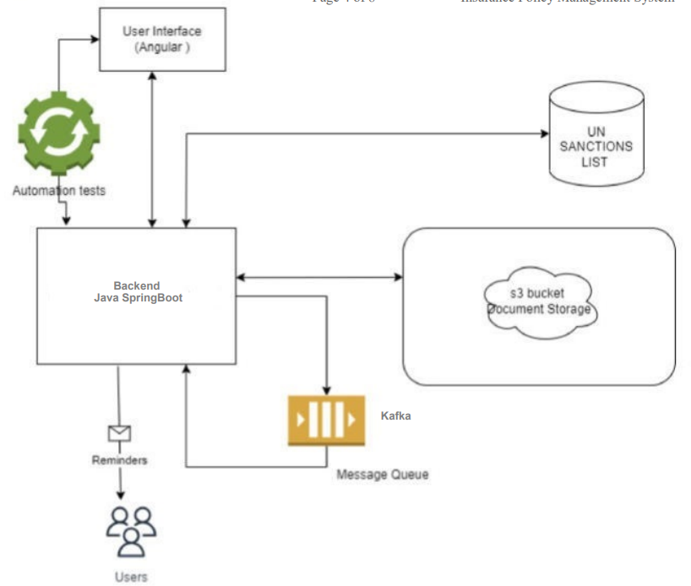
Data Flow Diagram

Slide 9
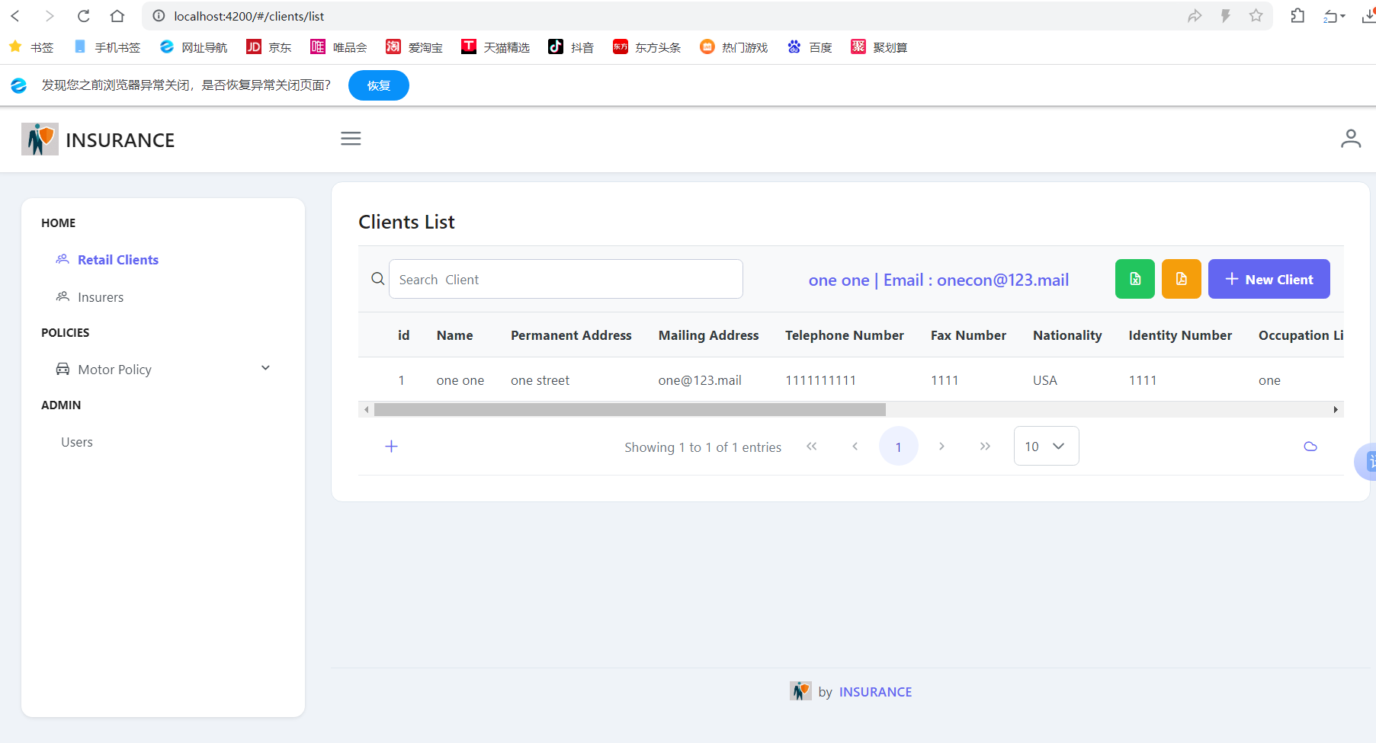
Test and Verification

Slide 10
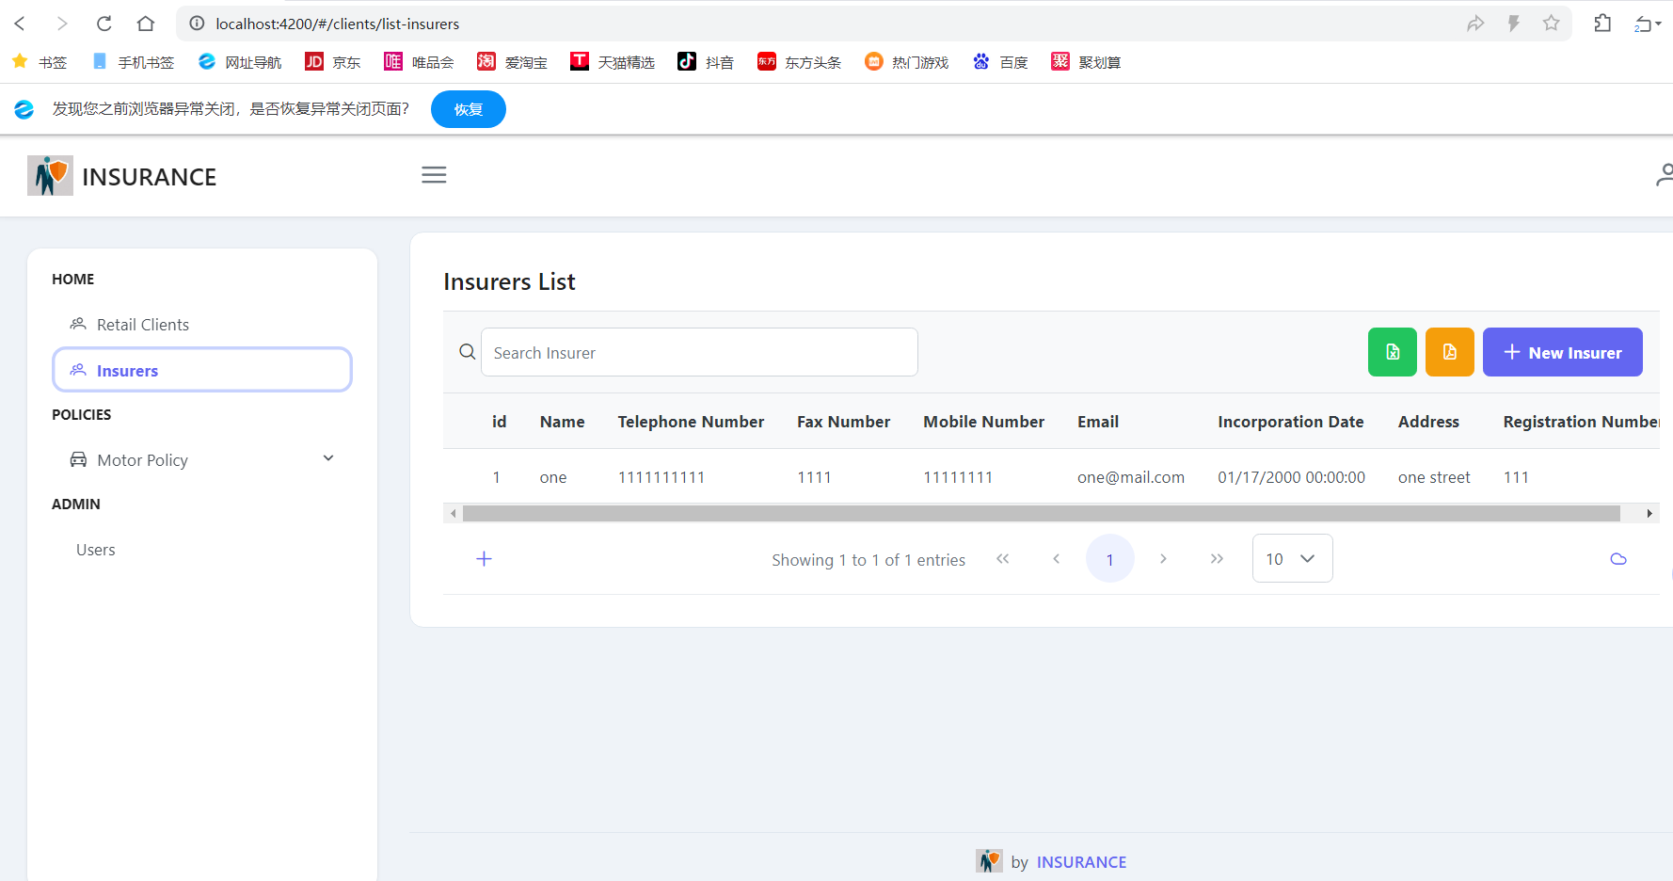
Test and Verification

Slide 11
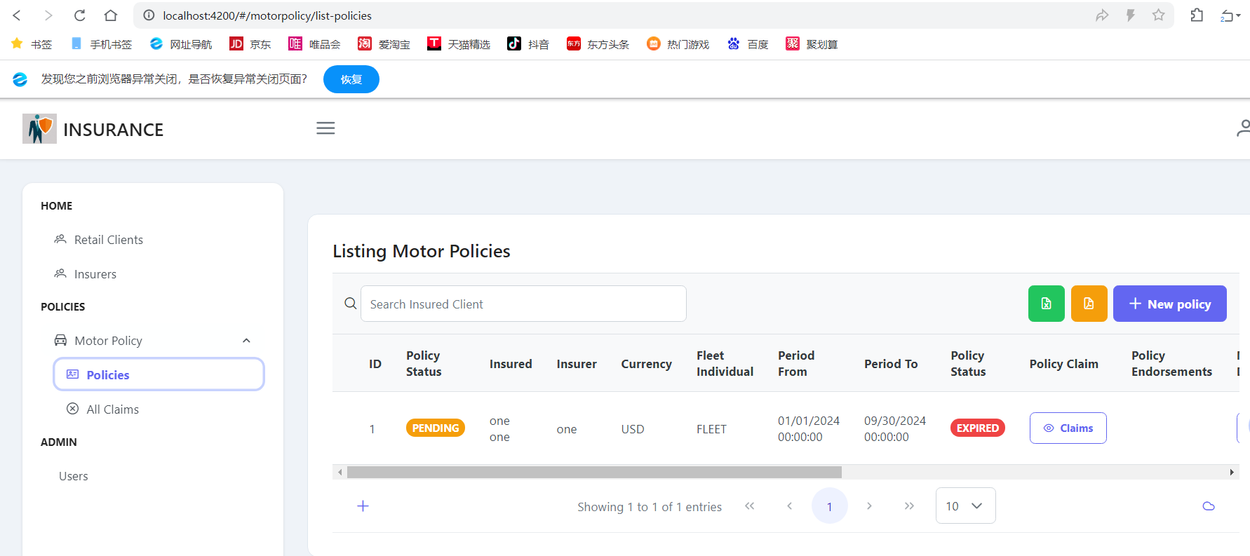
Test and Verification

Slide 12
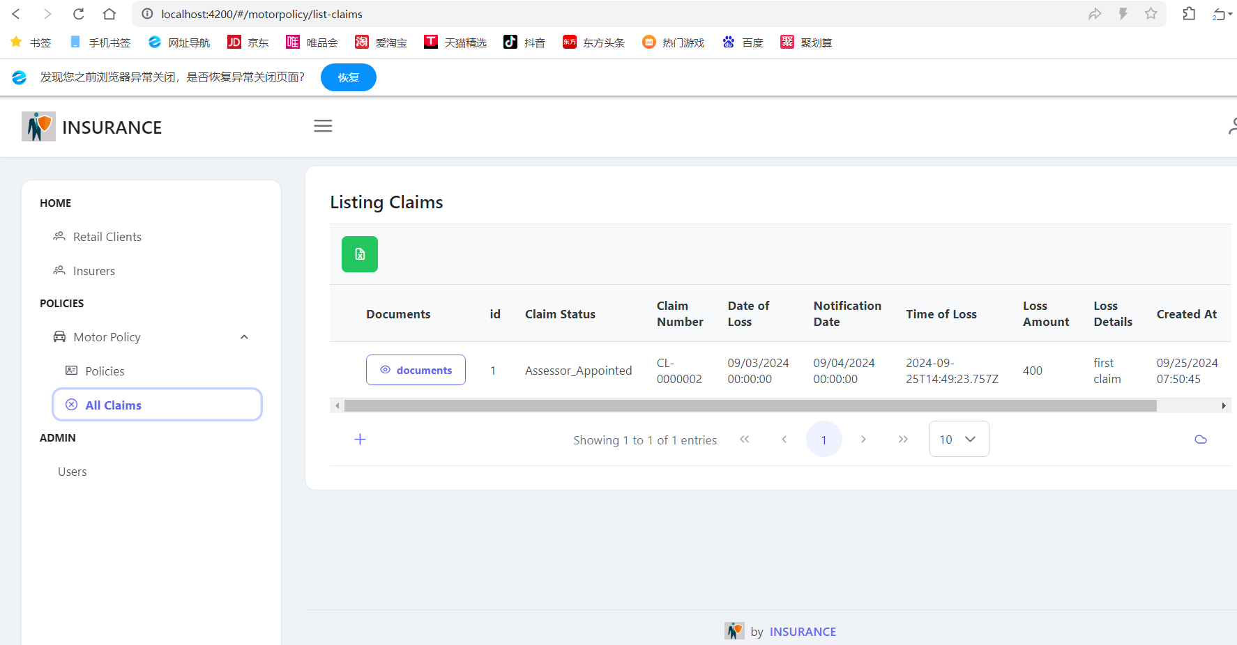
Test and Verification

Slide 13
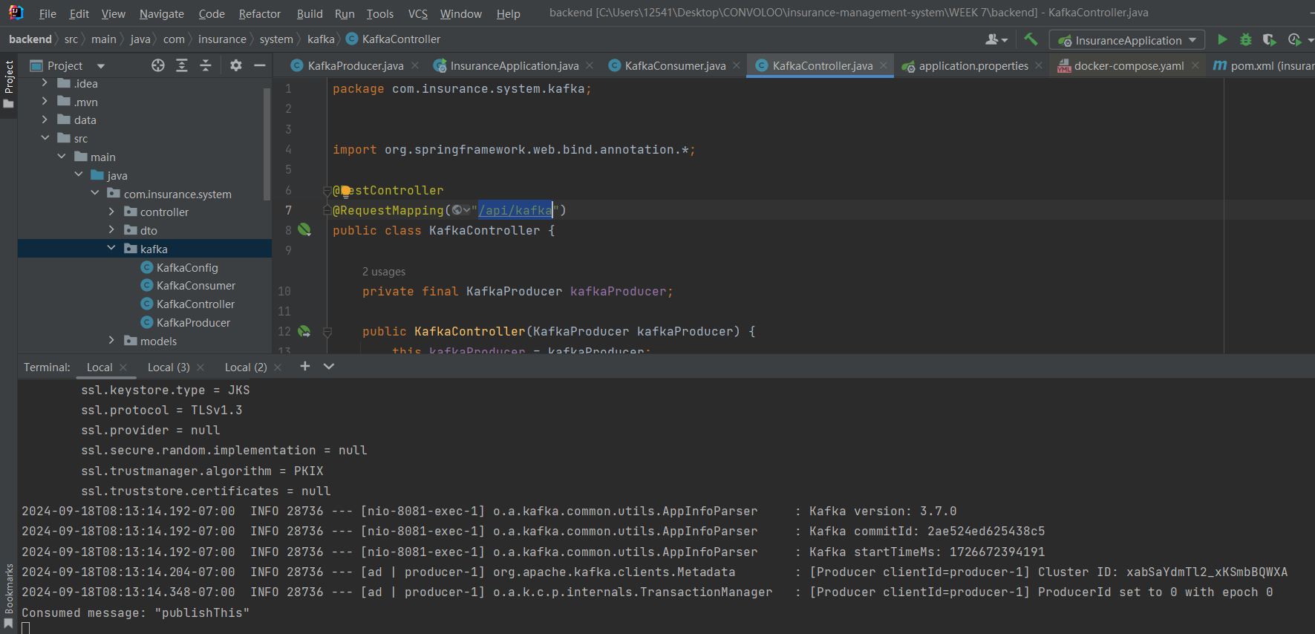
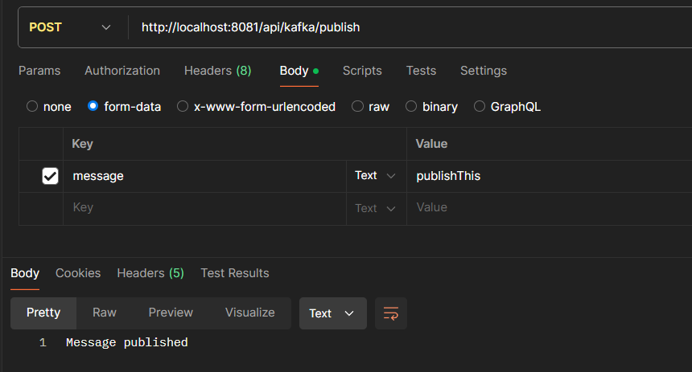
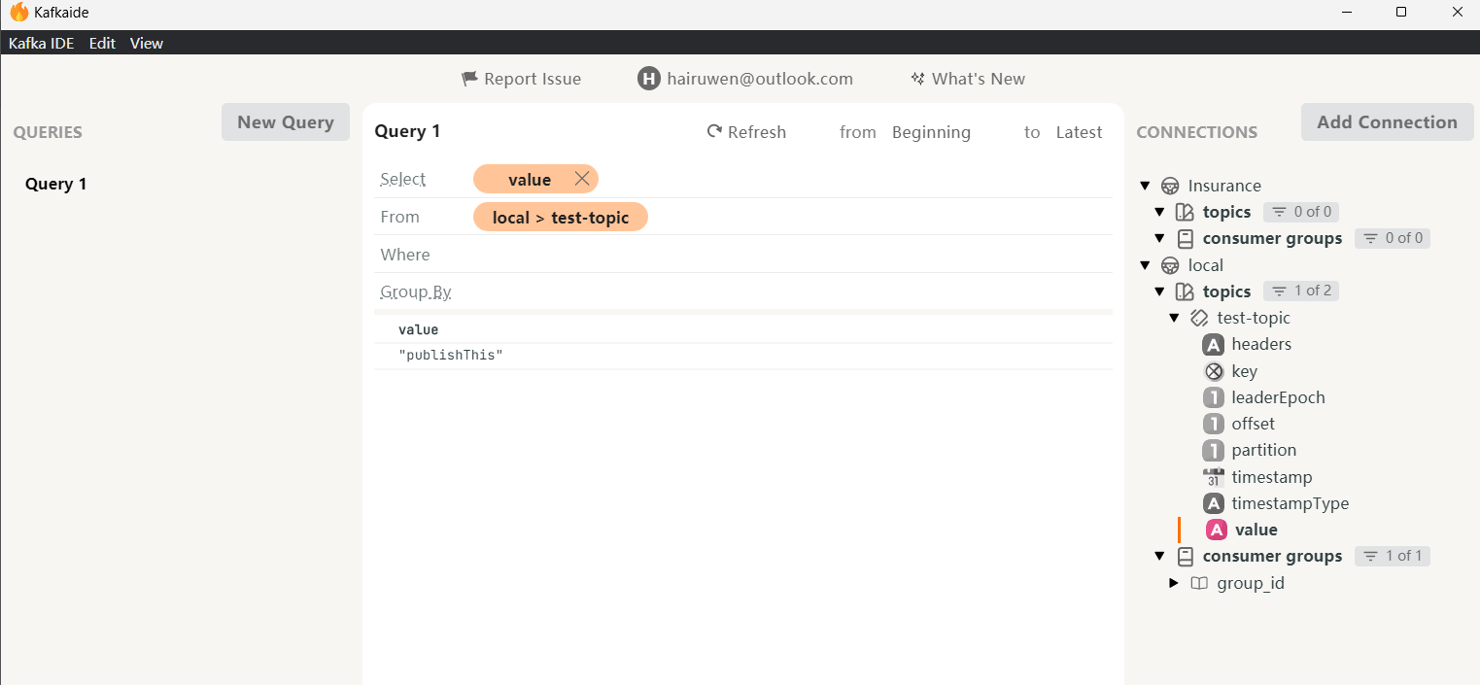
Test and Verification
SUCCESS!↓
→

Slide 14
Conclusion
This system enhances productivity and operational efficiency through a responsive interface built with
Angular. Users can effortlessly manage policies, submit claims, and upload documents. The Spring Boot backend ensures efficient claims processing, automated policy management, and generation of financial documents. Additionally, the system integrates with compliance checks for regulatory adherence.
Furthermore, the system prioritizes user experience with real-time communication through delivering
automated reminders and notifications. Secure document storage with AWS S3 guarantees the safety and accessibility of all insurance-related documents. Automated testing with Selenium ensures a stable and reliable user experience. This comprehensive solution position results in a cost-effective approach at the same time giving a competitive edge and fostering innovation within the insurance landscape.

Slide 15
Video
You should shoot a 3+ min video demonstrating -
How did you do the project?
Your coding work;
Your project result;
You can record the video on slack.

Slide 16
THANKS

